Slide 1
Measurement of Mitotic Index and duration of mitosis in given plant tissue
Cycle 5
Biology Laboratory
2017-18

Slide 2
Objectives
Understanding the process and different stages of mitosis
Visualize different phases of mitosis
Understanding the Importance of Mitotic Index and mitotic duration.
Procedure for preparation of the slide for mitotic plant cells

Slide 3
Points to be covered
Mode of reproduction: Asexual and Sexual
Cell division: Mitosis and Meiosis
Difference between cell division in Prokaryotes and Eukaryotes
Cell cycle and phases: Interphase and M phase (P,M,A,T)
Uncontrolled cell division: Cancer

Slide 4
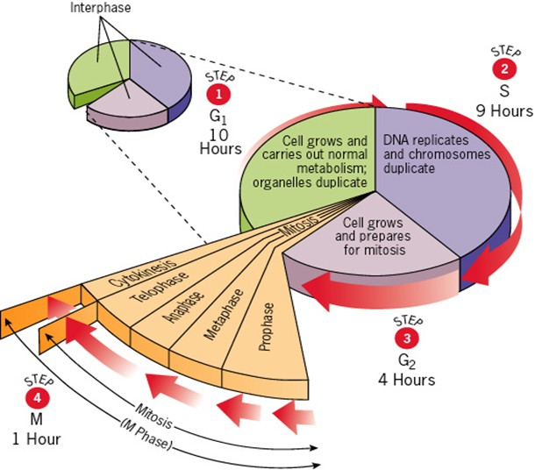
The Cell Cycle
M phase:
The mitotic division phase which involves the division of the cell.
G0 phase:
Cells escapes division and undergoes differentiation
G1 phase:
Preparation for DNA synthesis
S phase:
DNA replication
G2 phase:
Preparation for mitosis, ensures that it has everything required for division, else undergoes apoptosis (cell death)

Slide 5
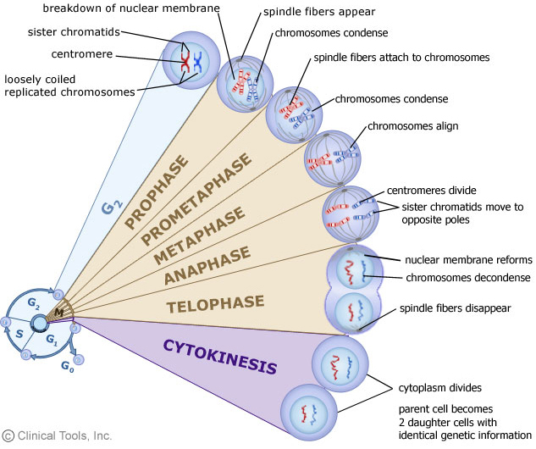
Cell division:
Mitosis: Produces two daughter with the same number of chromosomes, occurs in somatic cells of the body.
Meiosis: Reduction division; produces progeny cells with the one half the genetic content and number of chromosome as parent cell. Produces gametes/spores. (2n to n)
Stages of cell division

Slide 6
Stages of cell division (Contd..)
Prophase
Early in chromatin fibers shorten into chromosomes that are visible under a light microscope. (Each prophase chromosome consists of a pair of identical double-stranded chromatids.)
Later in prophase, the nucleolus disappears, the nuclear envelope breaks down, and the two centrosomes begin to form the mitotic spindle (which is an assembly of microtubules, which are components of the cytoskeleton).
As the microtubules extend in length between the centrosomes, the centrosomes are pushed to opposite "poles" (extremes) of the cell.
Eventually, the spindle extends between two opposite poles of the cell
Metaphase
Metaphase is characterized by the "metaphase plate". This is a mid-point region within the cell that is formed/defined by the centromeres of the chromatid pairs aligning along the microtubules at the center of the mitotic spindle.
Anaphase
The centromeres split separating the two members of each chromatid pair - which then move to the opposite poles of the cell: When they are separated the chromatids are called chromosomes.
Telophase
begins after the chromosomal movement stops. The identical sets of chromosomes - which are by this stage at opposite poles of the cell, uncoil and revert to the long, thin, thread-like chromatin form. A new nuclear envelope forms around each chromatin mass. Nucleoli reappear. Eventually the mitotic spindle breaks-up.

Slide 7
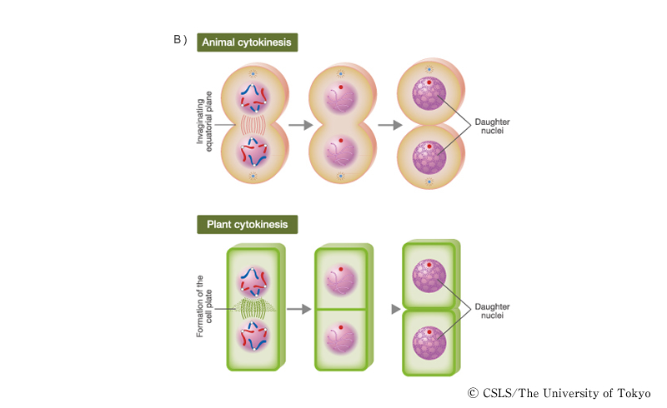
Differences between mitosis in plant and Animal cell
Mitosis in Animal cell | Mitosis in Plant cell
Centrioles are involved | Centioles are absent
Asters are formed | No aster formation
Occurs in tissues throughout the body | Occurs mainly in the meristems
Cytokinesis occurs through formation of cell furrow in cytoplasm | Cytokinesis occurs through formation of cell plate

Slide 8
Mitotic Index and its importance
The mitotic index is simply a measurement to determine the percentage of cells undergoing mitosis.
An elevated mitotic index indicates more cells are dividing,
The mitotic index may be elevated during necessary processes to life, such as the normal growth of plants or animals, as well as cellular repair the site of an injury.
Mitotic index = Cells observed with visible chromosomes / total number of cells visible
Applications of MI:
In order to predict effect of chemotherapy in cancer cases
Further, the mitotic index is an important prognostic factor predicting both overall survival and response to chemotherapy in most types of cancer.
In order to study the effect of environment on cell division
By quantifying aspects of a dividing cell population, we can examine how cells differ in their capability to divide. Experimentally, we can change properties of the cell's environment and quantify the effects on cell division.

Slide 9
Procedure
Step 1: Pre-treatment
Keep fresh and healthy onions for germination (in dark) in order to rejuvenate roots for active mitotic division
Once rooting is observed, cut the roots in the early morning (as cells are actively dividing in early morning) and wash them with water. Dry them on tissue paper and immerse in 0.1% colchicine (in order to arrest mitosis) for 6 hours
After 6 hours the colchicine treated roots are washed with water, dried on tissue paper and immersed in farmer’s fixative (to preserve cell structure) until used. The tissue remains stable in the fixative for about 1-2 months
Step 2: Preparing root tip squashes
Cut the root tip about 3-4mm from the tip (at the base of the meristem) and rinse thoroughly in distilled water (to remove any fixative from the roots)
Place the tip in 10% HCl (to make the tissue soft and create pores for enhancing staining) for 5 minutes and then wash with water.
Put the root tip in acetocarmine stain for 5 minutes and then wash with distilled water and put the stained tissue on the slide, place a cover slip on it.
Tap the tissue with flat end of glass rod/ tooth pick/ match stick gently to squash the tissue in order to get a single layer of cells

Slide 10
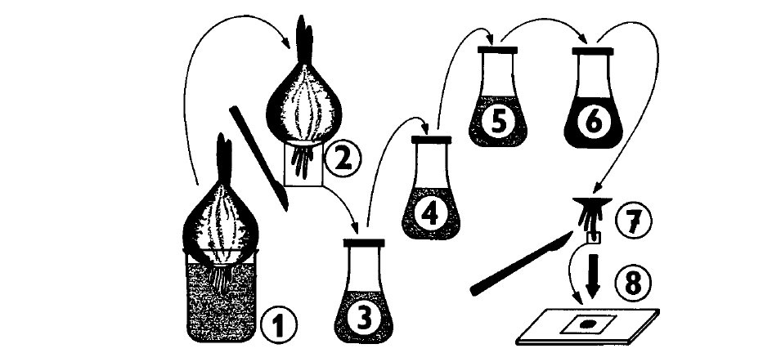
1 - Onions immersed in water to initiate rooting
2 - Once dense rooting occurs the roots are cut using a sharp blade/scissors
3 - The cut roots are washed in water, dried and immersed in 0.1% colchicine for 6hrs
4 - After 6 hrs the roots are washed with water, dried and immersed in Farmer’s fixative till used
5 - For preparing the slide cut the 3-4mm portion of the root from the root tip end and immerse in 10% hydrochloric acid for 5 minutes.
6- Wash with water and immerse in acetocarmine stain for 5 minutes.
7-8 - Wash the stained root tips and use for slide preparation

Slide 11
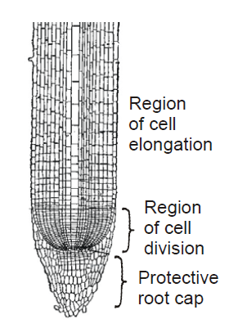
Why use onion roots for viewing mitosis?
• The roots are easy to grow in large numbers.
• The cells at the tip of the roots are actively dividing, and thus many cells will be in stages of mitosis.
• The tips can be prepared in a way that allows them to be flattened on microscopes slide (“squashed”) so that the chromosomes of individual cells can be observed.
• The chromosomes can be stained to make them more easily observable
Regions of Onion Root tips
There are three cellular regions near the tip of an onion root.
1. The root cap contains cells that cover and protect the underlying
growth region as the root pushed through the soil.
2. The region of cell division (or meristem) is where cells are
actively dividing but not increasing significantly in size.
3. In the region of cell elongation, cell are increasing in size, but not
dividing.
Viewing Chromosomes
Chromosomes generally are not visible as distinct entities in nondividing
cells, since the DNA is uncoiled, but the process of mitosis is facilitated by supercoiling of the chromosomes into a highly compacted form. Supercoiled chromosomes can be visualized in cells, particularly if they are treated with a DNA-specific stain, such as the acetocarmine.

Slide 12
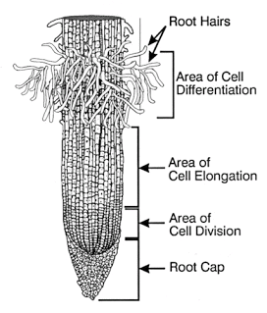
Root structure

Slide 13
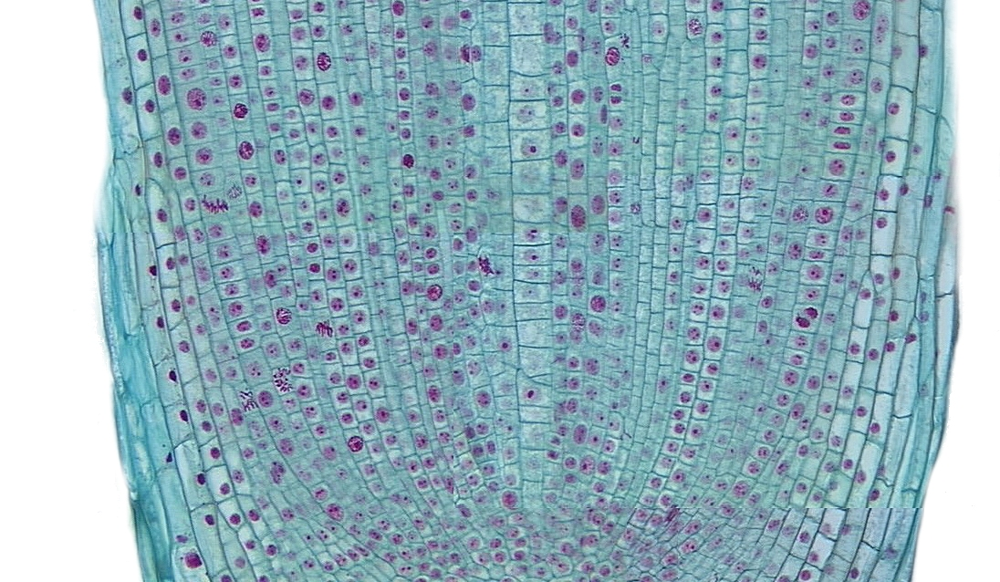
Region of Cell Division

Slide 14
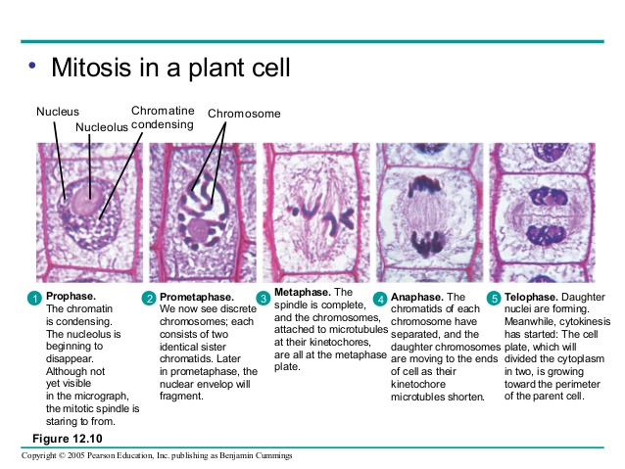
Mitosis in onion root tips

Slide 15
Role of various reagents for Slide preparation for mitosis
Colchicine: (0.1% solution prepared in water)
Colchicine is an alkloid obtained from the meadow saffron plant, Colchicum autumnale (Liliaceae) and other Colchicum species. This product is extracted from Gloriosa superba seeds or alternatively from Colchico autunnale seeds. At concentrations of 0.1-1 µg/ml, colchicine can cause the mitotic arrest of dividing cells (both plant and animal cells) by interfering with microtubule organization, in particular, those of the mitotic spindle.
Farmer’s Fixative: (Absolute alcohol and acetic acid in 3:1 ratio)
Characteristics of a chemical fixative
A good fixing agent should fulfill several criteria:
It must kill the specimen quickly: But be careful, some chemical fixing agents are toxic and are also harmful to the health of a person.
It must preserve the structures of the specimen, without introducing deformations or other artifacts. Insects may pull together their appendages, making them more difficult to see. The structures should then be sufficiently stable to withstand the dehydration and mounting.
It must enter the specimen well to react with all parts: This can be problematic with some specimens. Make sure that the specimen is sufficiently small. Alternatively it is possible to puncture the specimen (insects) so that the fixing agent can enter more easily. Some specimens may contain air bubbles which prevent the fixing agent to reach all parts. In this case it may be necessary to apply a vacuum to remove the air.

Slide 16
10% Hydrochloroc Acid:
Hydrochloric acid is added to the tissue after fixation in order to make the cells porous to the downstream staining procedures.
Acetocarmine Stain: (procedure for preparation of stain given in manual)
Acetocarmine stains the chromosomes specifically. In dividing cells the DNA being in a diffused form, the whole nucleus is visible as pink. In Prophase when DNA begins to condense in form of chromosomes, visually the nucleus still appears to pink completely. The difference between the non dividing cell and the prophase cell is the size of the nucleus. In prophase the size of nucleus is larger. Metaphase is distinctly visible as the chromosomes assemble in the centre of the cell. In anaphase the cells appear with chromatids moving in opposite directions. In telophase, two small nuclei appear in the same cell

Slide 17
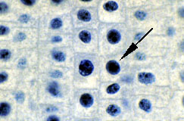
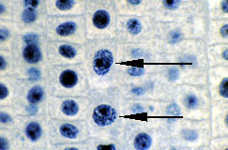
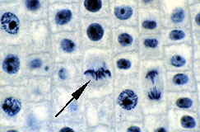
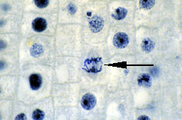
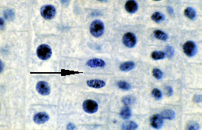
Interphase
Prophase
Metaphase
Anaphase
Telophase

Slide 18
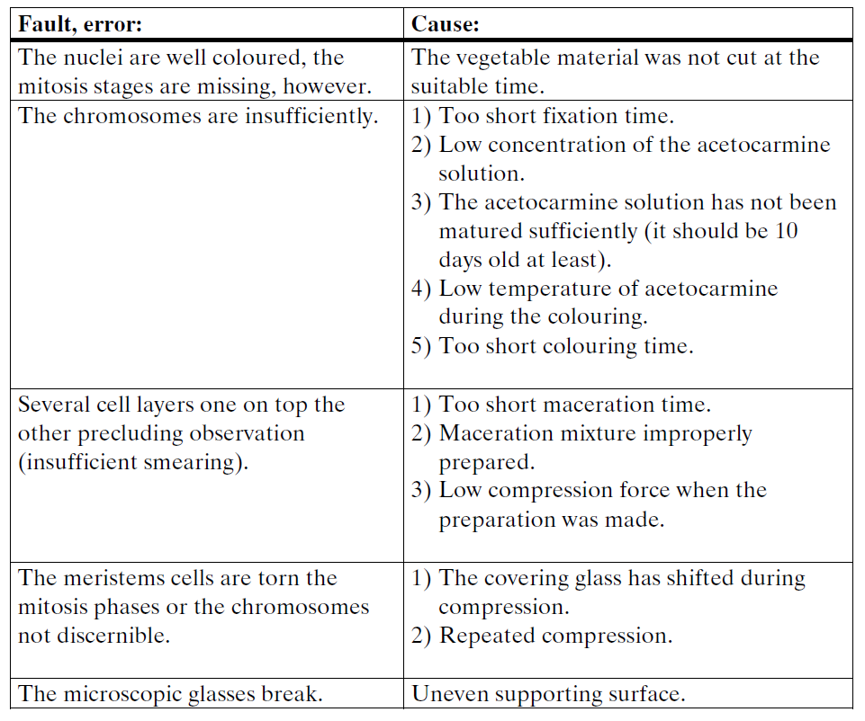

Slide 19
THANK YOU

